Slide 1
Airbnb Price Recommendation
Submitted to
Ma’am Beenish Ayesha Akram
Submitted by
Sayyeda Asma(2019-ce-10)
Zainab Rizwan(2019-ce-36)
Notes:
Are your classroom colors different than what you see in this template? That’s OK! Click on Design -> Variants (the down arrow) -> Pick the color scheme that works for you!
Feel free to change any “You will…” and “I will…” statements to ensure they align with your classroom procedures and rules!

Slide 2
Introduction
Airbnb, Inc. is an online marketplace for short-term homestays and experiences.
setting the right price for your listing can be a difficult task
Depends on various factors
location
amenities
number of bedrooms
number of bathrooms
Room type
Neighbourhoods
Machine learning models such as Linear Regression and Random Forest Regressor can help Airbnb hosts to predict the optimal price for their listing based on historical data.

Slide 3
Dataset
Airbnb dataset on listings of Amsterdam
Dataset size (6998, 75)
Total 75 attributes
6998 rows
Dataset link http://insideairbnb.com/get-the-data/

Slide 4
Features Engineering 🡪Data cleaning
Problems in dataset | Solution
Removing irrelevant columns Dealing with missing values Converting categorical data to numerical values Removing duplicates and data inconsistencies Removing amenities that are rarely used Data transformation for columns | Based on the assumptions Replacing them with either 0 or median/mean of that entire attribute Using label encoder Categorizing amenities Removed characters

Slide 5
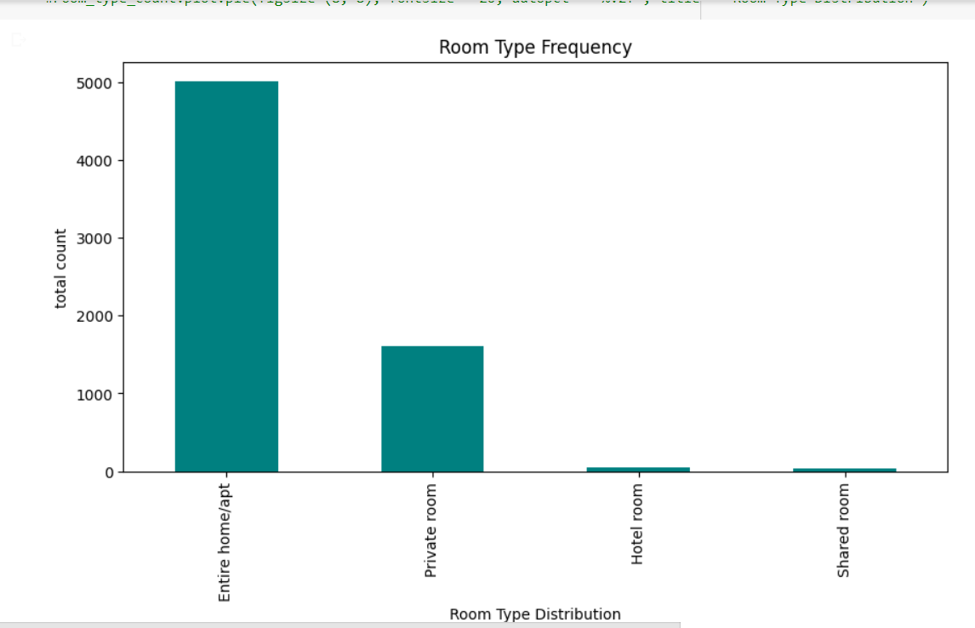
Data Analysis
Entire home apt is the most commonly occurring room type in Amsterdam

Slide 6
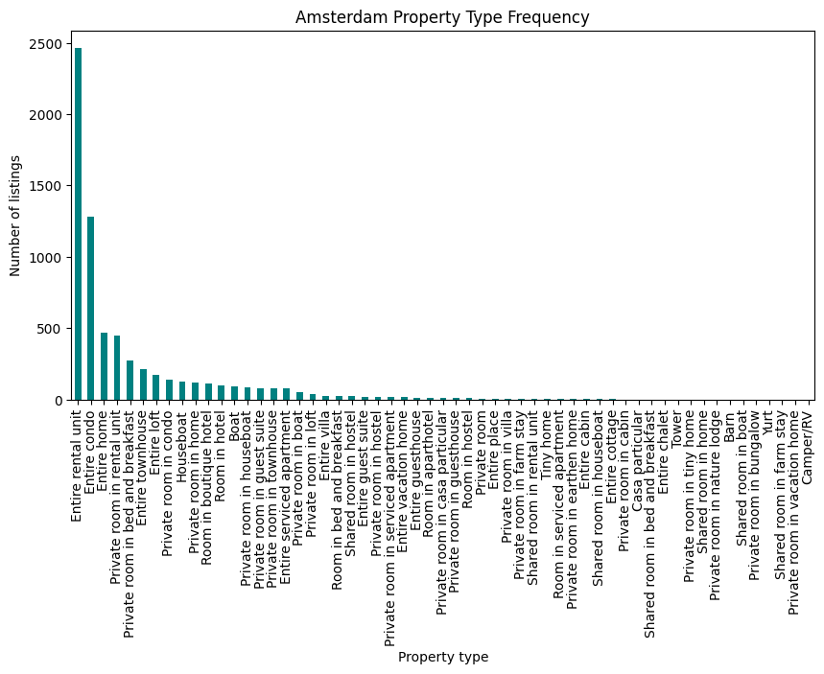
Data Analysis
entire rental unit property type is most commonly occurring property type in Amsterdam

Slide 7
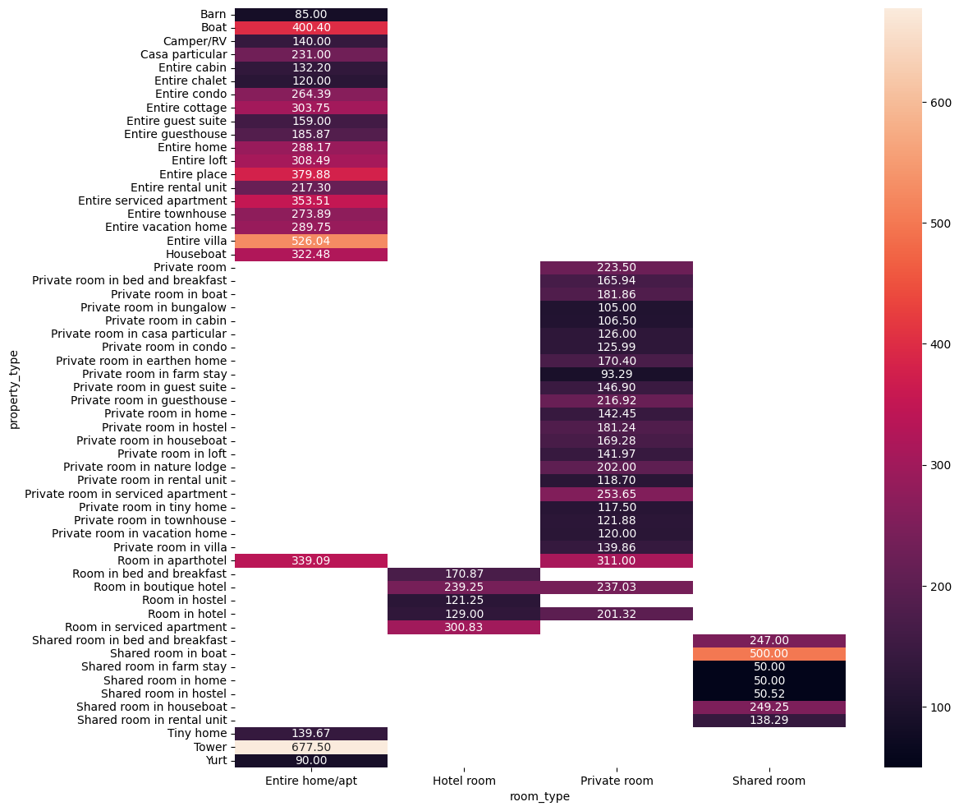
Data Analysis
Entire villa and tower property type with room type entire home apt has the highest price
Shared room in home and hostel with room type shared room has the least price

Slide 8
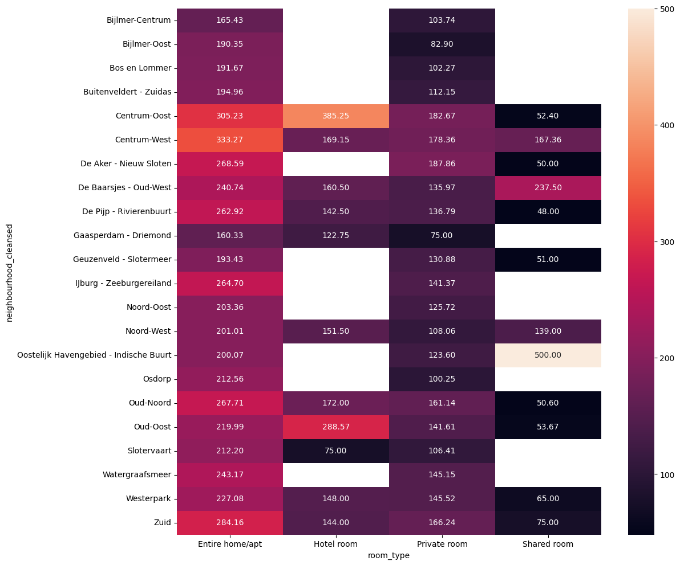
Data Analysis
Shared room in the neighborhood Oostelijk Havengebied - Indische Buurt has the the highest price

Slide 9
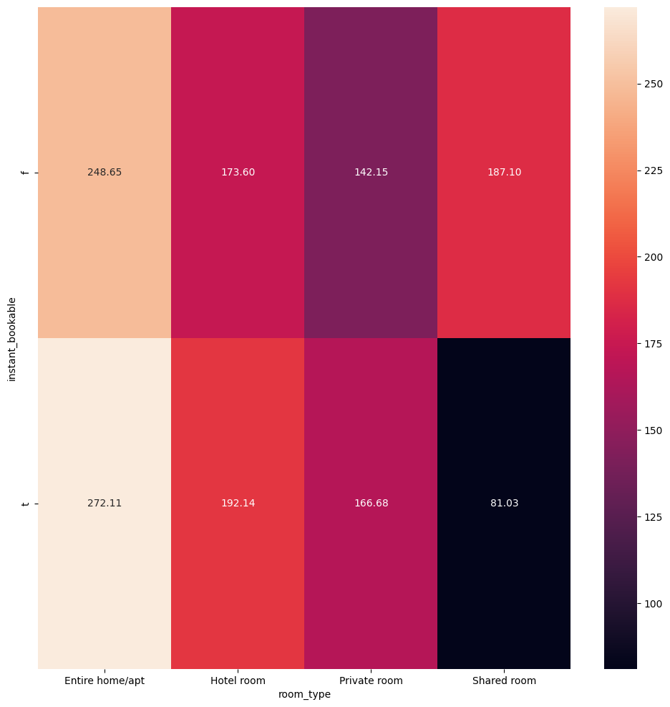
Data Analysis
Room types that are instant bookable have the highest price then those rooms that can not be instantly booked except shared room

Slide 10
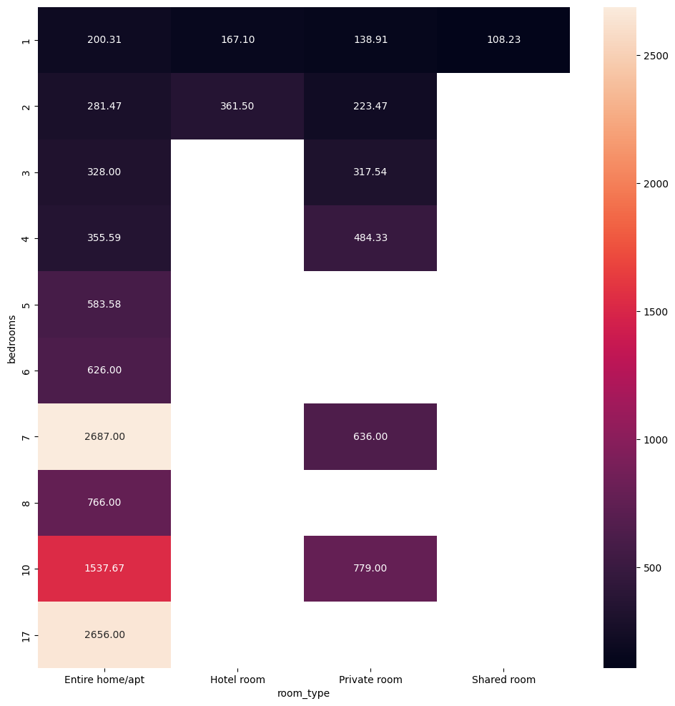
Data Analysis
17 and 7 bedrooms with room type entire home apt have the highest pricing among all room types and number of bedrooms
Only 1 room in the shared room category has the minimum price

Slide 11
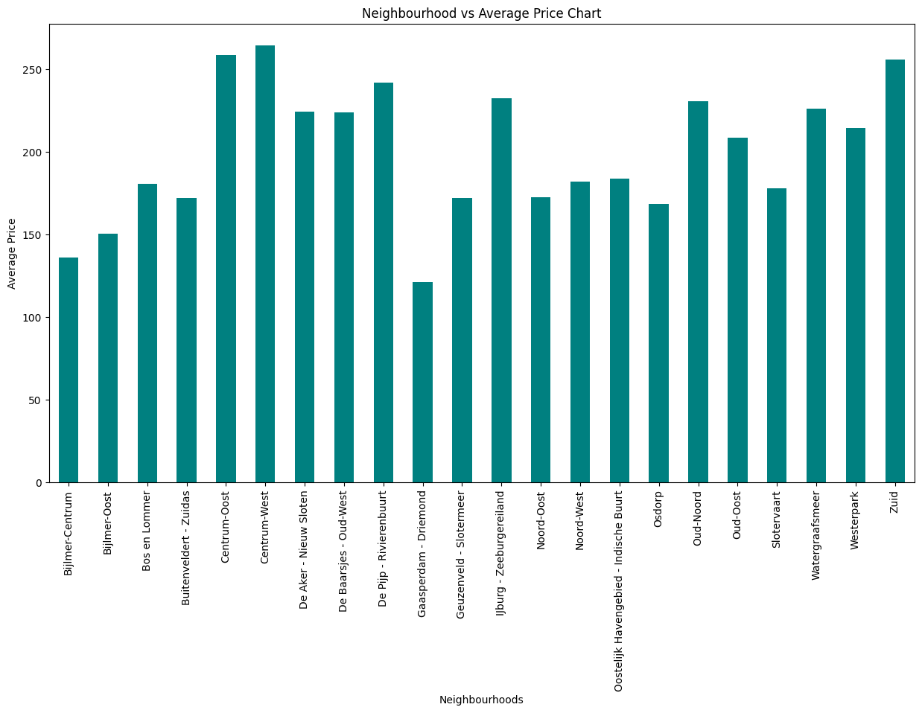
Data Analysis
centrum west neighborhood has the highest average price among all neighborhoods while gaasperdam driemond has minimum average price.

Slide 12
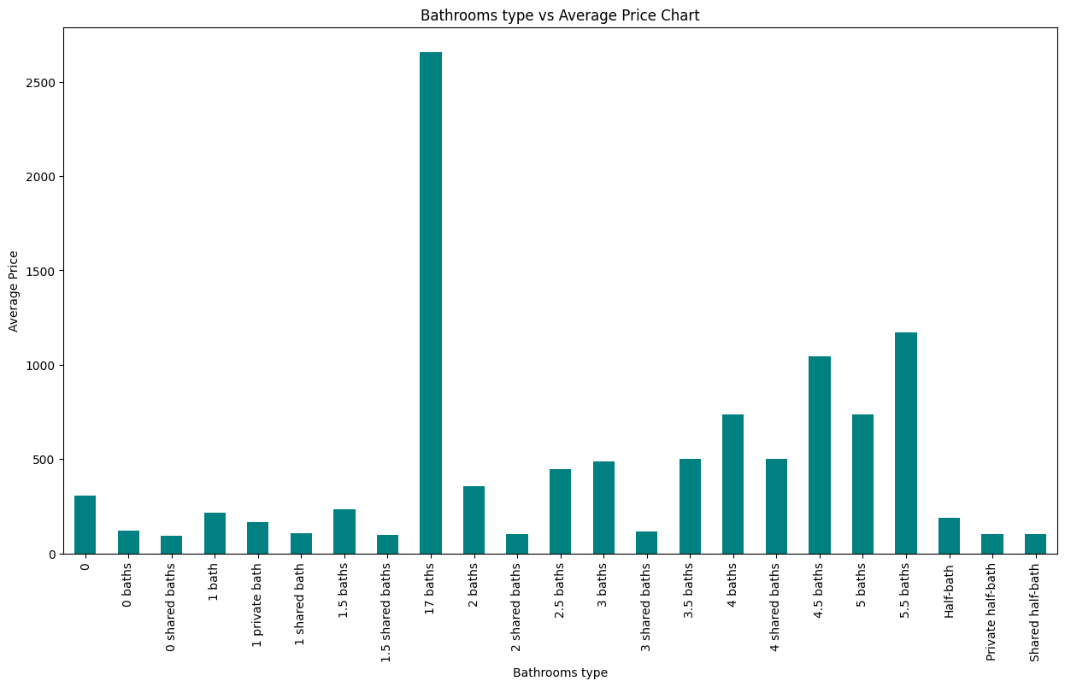
Data Analysis
listing with 17 bathrooms have the highest average price while.0,1,2 and 3 shared baths, private half bath and shared half bath have minimum value for average price.

Slide 13
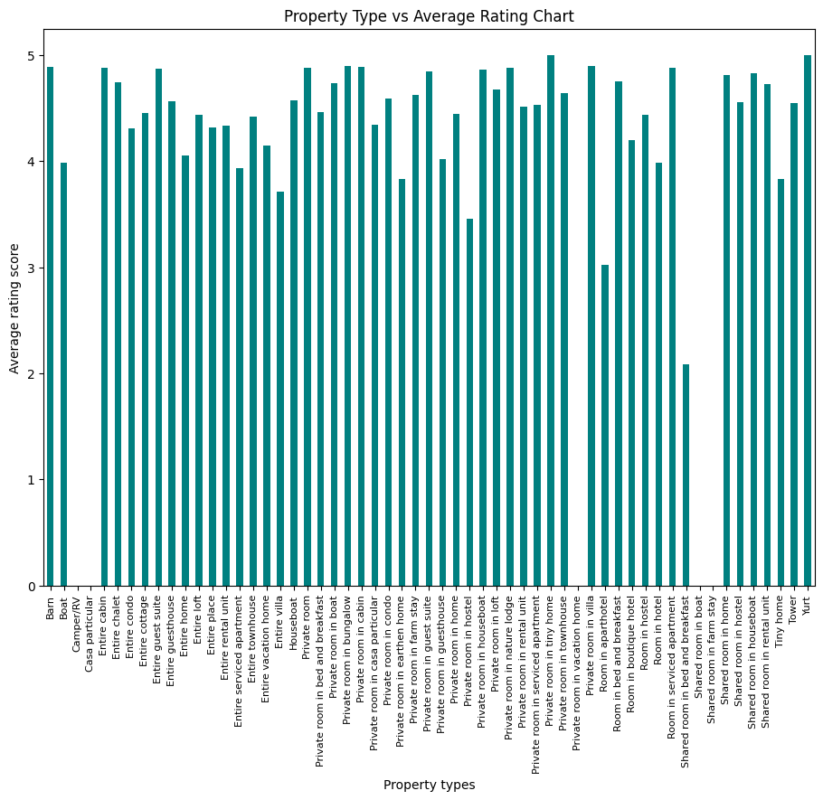
Data Analysis
yurt barn and entire cabin property has the highest rating amongst all property type.

Slide 14
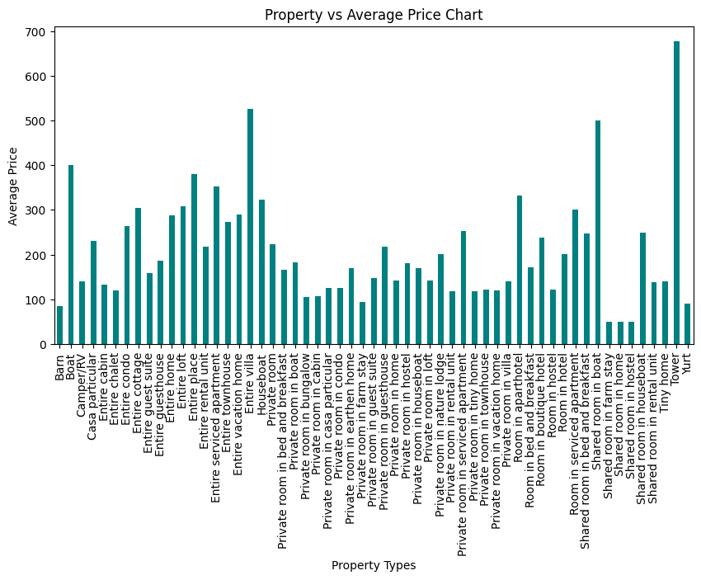
Data Analysis
tower property type has the highest value for average price. Shared room in farm stay ,home and hostel have minimum value for average price.

Slide 15
Machine Learning Models
Linear Regression
Behaves poorly on dataset even after applying PCA
Accuracy on training set 32 %
Accuracy on testing set 48.8%

Slide 16
Summary of Results for Linear Regression
Linear Regression | Accuracy
Accuracy on training set | 32%
Accuracy on testing set | 48.8%
Accuracy on training set after Applying PCA | 30%
Accuracy on testing set after Applying PCA | 50%

Slide 17
Machine Learning Models
Random Forest Regression
Behaves comparatively well then linear regression
Accuracy on training set 89%
Accuracy on testing set 59%

Slide 18
Summary of Results for Random forest Regressor
Random Forest Regressor | Accuracy
Accuracy on training set | 89.6%
Accuracy on testing set | 59.6%
Accuracy on training set after Applying PCA | 90%
Accuracy on testing set after Applying PCA | 59%
Accuracy on training set after feature importance | 89.6%
Accuracy on testing set after feature importance | 62.3%

Slide 19
Research analysis
Airbnb Price Prediction with Sentiment Classification
https://scholarworks.sjsu.edu/cgi/viewcontent.cgi?article=1979&context=etd_projects
Analysis of price determinants in the caseof Airbnb listings
https://www.tandfonline.com/doi/epdf/10.1080/1331677X.2021.1962380?needAccess=true&role=button
Price Prediction in the Sharing Economy: A Case Study with Airbnb data
https://scholars.unh.edu/cgi/viewcontent.cgi?article=1511&context=honors

Slide 20
Conclusion
The best performing model was able to predict 59.7% of variation which means we still have a remaining of 40.3% unexplained.
This could be due to several features that are not part of our dataset. The need to analyze our features more accurately.

